Slide 1
The Treasury Technology today and the concept of “Smart Treasury”
Todays Discussion Points
Overview
Technology as we know It
Technology as we should know It
Predictions for the future
Questions
Notes:
1 – thank everyone for coming along today
2 – thank Paychex and AFP for inviting you along to the session to speak.
3 – Introduce yourself – Tom leitch Head of Sales for North America and UK
4. What we are going to be covering today and why
Overview
We will run through an overview of the current Treasury Technology looking at the role treasury technology plays and how they have evolved.
How has consolidation affected the evolution of Treasury Technology in the last few years.
Technology as we know It
Technology as we should know It
Predictions for the future
Questions

Slide 2
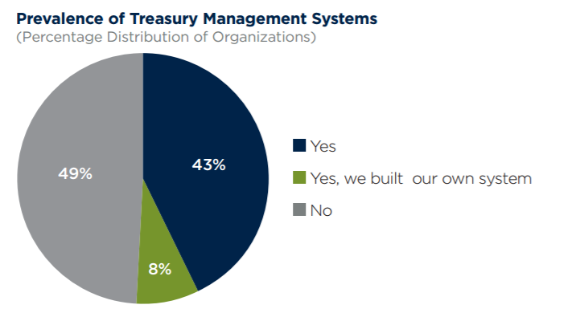
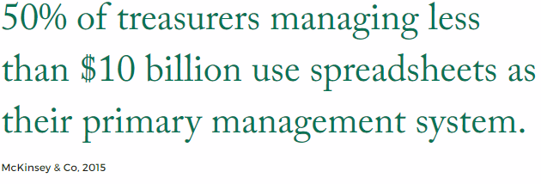
Who currently uses a Treasury Management System?
51% of corporates currently have a TMS

Slide 3
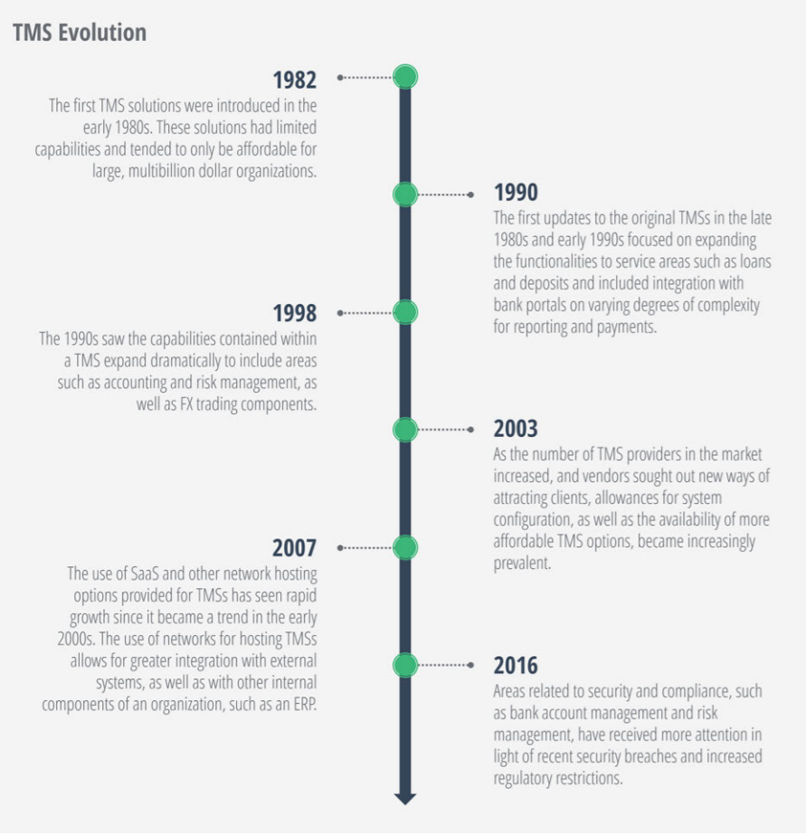
Overview

Slide 4
Overview
For nearly a decade we have been hearing about “The New Normal” – did technology every really deliver to match the needs and expectations?
Disruptive TMS/TWS are no longer tools that just provide automation, audit and visibility. What are they?
What corporate treasurers may see as their top requirement now may not be the case in 2 years.
Are treasurers able to change the status quo to solve their problems.
Notes:
Has the new normal really happened – We have seen other areas of businesses such as HR, Marketing and personal finance dramatically change but has treasury really evolved at the speed it should be?
1.1 Has been consolidation of the market place stagnated the developments of systems? We have seen for example ION take over Treasura, IT2, City Financials and now Reval. What developments have we really seen coming from these acquisitions? In my personal view they have just acquired and held onto these companies without investing or updating the products.
1.2 is big really the best with these huge leviathan of a system that in my experience treasurers use less than 20?
2.1 If we look at the disrupters in other areas like accounting with Xero the questions is are these smaller more nimble firms out there more equipped to have their finger on the pulse and quickly adapt to changes. –
3. With an more than ever volatile political and financial environment are corporates able to change their focus from today to the future and also companies are looking else where to expand their reach and how this affects priorities.
4. Are treasurers able to make the changes to the status quo or does the structure not allow it.

Slide 5
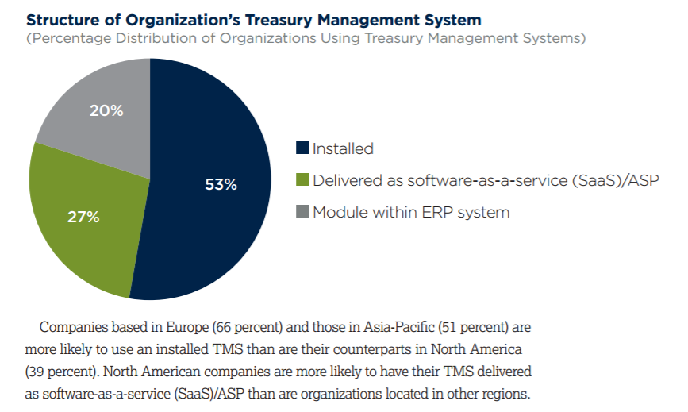
Treasury Technology as we know it….
Implementation – Installed & Cloud
Connectivity – Host to Host, SWIFT and inter-system
Notes:
Technology plays a pre-eminent role in providing intelligence to a treasurer’s daily life. The expected role of technology is to detect events, gauge their relevance against predetermined thresholds, and take action. While technology should not replace human decisions, it should be able to identify critical items and provide intelligence for command- and control-like operations.
Software solutions for treasury have evolved from basic standalone treasury workstations, where automation would lead to the business objective of efficiency, to interconnected treasury management systems (TMSs) covering cash management, forecasting, and risk management tools.

Slide 6
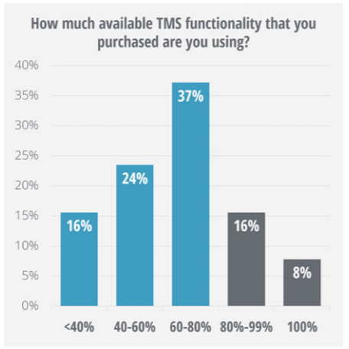
Treasury Technology as we know it….
Functionality – Cash management & visibility, Payments, FX, Debt & Investments and Risk Management.
77% of treasurers are using less that 80% of functionality
Scalability might be the issue

Slide 7
Treasury Technology as we know it….
Customizability
Notes:
Generating reports for company management and financial oversight are key tasks for most treasury departments. Treasury management systems can be useful in this regard and can assist in streamlining the process. However, the survey results reveal different opinions about the ease with which TMS can help with this task. Forty-nine percent of survey respondents report that updating reports and workflows via their organizations’ TMS is difficult. Another 34 percent believe it is a satisfactory process but only 16 percent say it is easy to do so. The perception regarding the ease of updating reports and workflows is fairly consistent across organization size. Updating reports and workflows is considered to be more challenging at organizations located in North America (65 percent)

Slide 8
Limitations and barriers to adoption and use within Treasury Technology
What are the barriers that are stopping treasurers from adopting Treasury Technology
What are the limitations of Excel
What are the limitations of a TMS

Slide 9
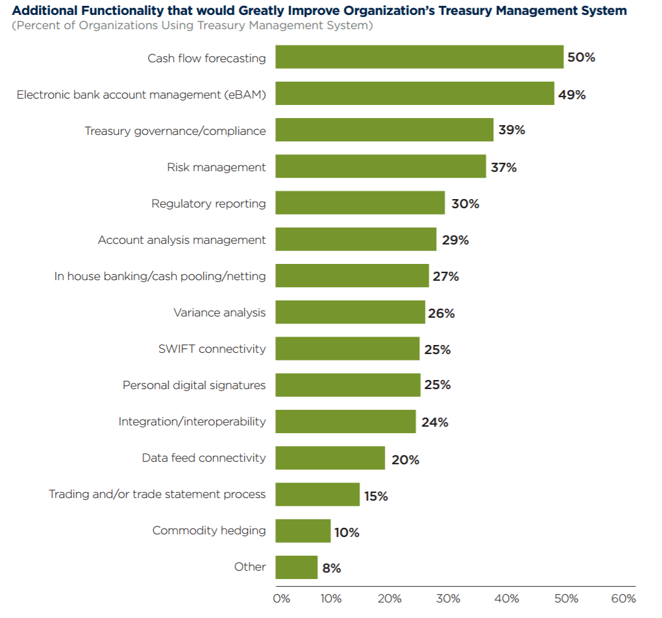
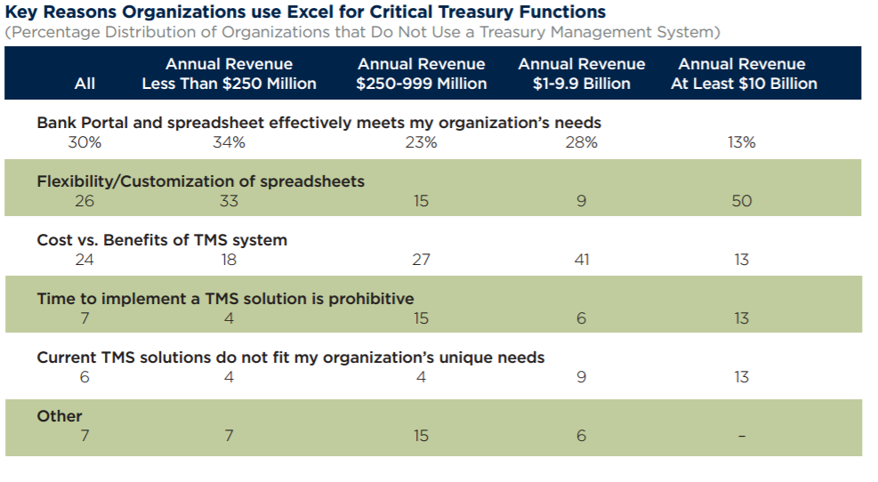
Traditional barriers and Limitations
Price of Solutions.
BAM/eBAM
Forecasting
Notes:
1. There is no longer the justification for providers to be expensive.
Lets break this down a little for everyone so that you can understand the true cost of a treasury technology from the point of the vendor and why this cost isn’t translated to the customer.
Transparency drives down costs “The concept of bringing transparency to financial institutions is permanently disruptive,” said Mike. If people knew how much things cost, they would be less likely to pay the high margins offered by traditional financial services companies. However, as costs come closer to zero, these firms will need large economies of scale, a better product offering and new ways to generate revenue
Hosting services – Amazon and Microsoft services since the advent of cloud computing and the increased adoption of it in 2006 has meant that the fees associated with this service are roughly $100 per month.
Connectivity – Host to Host – I can tell you it takes roughly 8 man hours from the point of the vendor to set up these links with the banks and test the functionality. If we look at SWIFT providers they have dramatically reduce the fees with setting up alliance lite 2 and providing the services for customers and also TMS providers ability to offer these services.
BAM/eBAM – the lack of a universally adopted set of rules around what the banks will except in order to change signers, open and close accounts et.
Forecasting – the vast majority of corporates are still using excel or TMS functionality is limited in the ability to take forward action on forecasts etc.

Slide 10
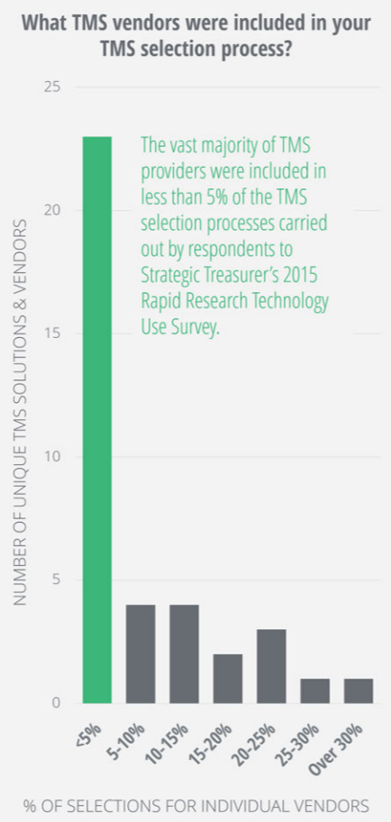
Limitations and barriers to adoption and use within Treasury Technology
Notes:
What might be the limiting factors may be because of the selection process and how it is missing the vast majority of vendors out who can serve the treasurers needs better.

Slide 11
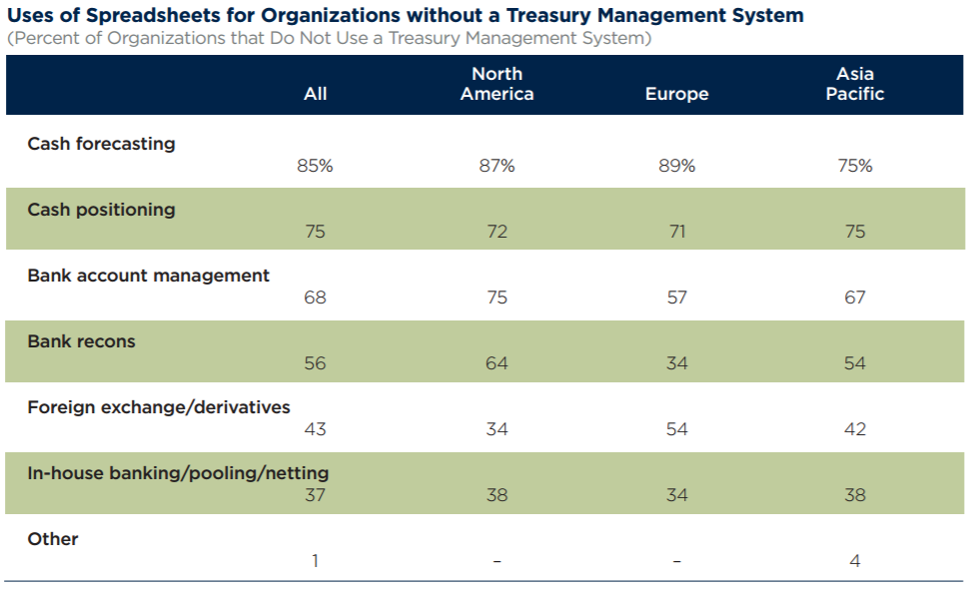
Treasury Technology as we should know it
Predictive
Forecasting – Technology now enables forecasting to have predictive scenarios and ease of adoption by not fundamentally changing the way treasurers operate.
Machine Learning – the power of insights and the ability to recommend actions that they are highly likely to execute (example)
Social Treasury – Treasury increasingly has to become more social due to evolving trends externally.
Integrating all aspects of the system to external systems
Notes:
What we are looking at is the emergence of something that was coined back in 2011 by Aite Group called TiMS
“treasury intelligence management system” (TiMS), the next generation of systems for treasury that provide in-context information as the prerequisite for intelligent business decision-making.
Treasury solution vendors must develop functionalities that provide transparency on what creates the decisions. Rather than wondering what features are built in the system, treasurers will soon ask why they are built and what intelligence they provide to support business decisions. TiMSs will collect data, elaborate the relative information, and turn it into decision-support intelligence. TiMSs will make TMSs actionable.
In fact, information was defined in a keynote presentation at the Sibos back in 2011 which picked up on the importance of information by calling it “the oil of the 21st century.”
Forecasting – “What changes are we seeing in forecasting and what does this mean for the treasurer”
1. Excel still is the prefered choice for treasurers
a. Breaking the reliance on excel and disrupting the largest factor of adoption – pride in the excel
b. Not changing the way treasurers fundamentally work but putting it into a controlled enviroment
c. Sharing of data – systems should be able to talk to other systems or treasurers should be able to share with other treasuers easily the information with the solution. (Should not be priced by user.
d. Predictive forecasting and how the TMS should make recommendations based off predicitve scenarios around fuinding, itinary, seasonal trends.
2. How predicitive can a system become?
Ultimately, you no longer tell the system what to do; the system will tell you what you can do. Interactions then become smart and more meaningful.
Machine learning is a type of artificial intelligence (AI) that provides computers with the ability to learn without being explicitly programmed. Machine learning focuses on the development of computer programs that can change when exposed to new data. The process of machine learning is similar to that of data mining.
“Social Treasury” what we mean by this?
Treasury Goes Social
There’s an increasing convergence of what is used at work and what is used day-to-day and it’s getting more pronounced. For example, almost everyone uses WhatsApp to organize business matters, LinkedIn to get an overview of a certain individual you might be meeting and Google Calendar to get more visibility of your work schedules.
What does this mean in the treasury space?
Since treasury is something that can be central in the treasury operations, the social element will be more noticeable in these systems. This could mean having virtual team-rooms, instant messaging capabilities, and files that are archived and searchable.
File sharing is becoming very common. One can easily start sharing certain files and transactions. They can tag excel files as notes to certain transactions in the system for easy referencing.
Treasury will become more integrated with mobile devices. Easily make decisions, communicate with team members, and approve decisions through mobile devices.
1. The system should allow treasurers around the world to talk to one another, even in decentralized structures.
a. The TMS will become a communication hub of communication of events
b. Payments due, country holidays, forecasting, month end duties
c. Reporting – how customizable can the treasurer make the solution without intervention of the vendor.
d. Systems need to talk to systems its not necessarily people, systems also need to speak with each other and share information

Slide 12
Treasury Technology as we should know it
API Adoption – The rise of API’s and the creation of Treasury app store / market place, disruption to market data providers, connectivity
API Payments – How the ease of adopting Payment Factories is helping companies.
Notes:
API adoption – how this can create a bolt on service to current systems and set up. Take an ERP for example if you would like to send payments through he systems workflow why do you need to by a workflow. There are tools out there that will allow corporates to have these services at a low cost.
The advantages on the corporate customer front could include:
Improved operational efficiency: Customers can run banking out of enterprise resource planning (ERP) with automated reconciliation.
Improved scalability: Exposing APIs and an expanding community of digital developers will enable banks to innovate and cater to their corporate clients’ changing needs.
Ease of implementation: Assisting the execution of parallel projects, using an ecosystem of APIs and vendor developers. In addition, the absence of user interface/user experience (UI/UX) significantly reduces development time.
High level of security: The overall risk in the system lessens, with a connected financial ecosystem reducing losses and cost from fraud and defaults.
Offering instant banking facilities: Enabling 24/7 real-time transaction processing for corporates, without any lead time in transaction booking and payment.
Standardisation: Clients don’t have to undergo changes to suit each bank’s distinct mechanism or processes.
A more seamless and realtime process with the bank will allow a very frictionless experience in setting up a Payment factory and delivering the payment files to the bank.
Treasury teams around the globe have a daunting list of responsibilities With hundreds of bank accounts spread across multiple banks in different jurisdictions; however, most treasury departments are unable to effectively meet rising demands. Because of the manual effort involved in most processes, they’re unable to achieve clear and timely visibility of all bank accounts or even access and move surplus balances.
The result is payment processes strewn with error, multi-bank arrangements ending in an array of bank connectivity products and a lack of accurate, timely reporting, which all leads to inefficiencies in the business.
Business is challenging enough, there’s simply no need to endure additional unnecessary complications. For broader, more accurate visibility, organisations can adopt best practice methodology and take an integrated approach to technology that will help them meet their business needs.
Disparate processes and excessive manual effort
The drive to improve internal processing controls and financial reporting across the enterprise is a continual one. Unfortunately, lax control measures and manual intervention creep in over time. The absence of efficient, rules-based technology and effective reporting has created an over-reliance on manual intervention in many parts of a treasurer’s operation until now.
Top tip: Implement a platform, such as a payment factory, that can standardise procedures and automate internal controls such as workflow and segregation of duties, limits and auditability. It should offer comprehensive, accurate reporting and strengthen visibility into all multi-banking, payments and treasury activities.
Cross-border payments
Understandably, many organisations see little alternative to using cross-border payments to settle their obligations in other countries. These might relate to supplier payments, payroll and other local debts. In countries where there are significant concentrations of payments this is not cost effective and runs the risk of payments going astray or being delayed.
Top tip: Instead of making large volumes of cross-border payments, consider opening bank accounts in countries where you have subsidiaries or a high concentration of payments, and then funding these accounts with low volume, high value cross-border payments from the head office. The in-country disbursement bank accounts can then be managed centrally to initiate large volumes of local automated clearing house (ACH) payments. This will save both time and money, without losing visibility or control, and enable you to manage local liquidity more efficiently.
Poor visibility resulting in a questionable cash position
To start, Treasury teams generally don’t have access to all the bank account information they need to do their jobs effectively. To make matters worse, payments and cash positions are often tracked separately. Banks also have a differing range of service levels that they can provide to customers. Manually consolidating data from multiple sources into spreadsheets leads to errors and inconsistencies, forcing decisions to be made based on outdated information.
Top tip: Implement a solution such as a payment factory that provides real-time global access to transactional payment information and account balances across all enterprise applications, payment types and banks. Make sure it can combine data transformation with reconciliation, giving you a more accurate and clearer picture of cash flowing in and out of the organisation.

Slide 13
Treasury Technology as we should know it
Democratization of Treasury Technology
Adaptability – How the core operating systems are now built to fluidly adapt to changes in the market. (Christmas lights)

Slide 14
The Future of Treasury Technology
What do you as corporates think is going to happen in the future with treasury and treasury technology?

Slide 15
The Future of Treasury Technology
Security
The unstoppable rise of AI
Blockchain
Frictionless technology leading to a global market
place with the increase in API’s and information sharing
Notes:
This did NOT come out as a common trend, but was cited once or twice. Surprising really, as it’s a key concern for all. As Bob’s Guide puts it, “The trend is top of mind for banks and businesses going into 2017 due to consumer protection, credit quality concerns, the new age of capital planning, and increases in cyber threats and attacks.”
“There is a real chance that a bank will fall in 2017 as attacks get more advanced and the hackers get further inside the network,” Aden Davies says. “The challenges faced by SWIFT in 2016 show that critical infrastructure is at risk and it only takes a handful of weaknesses to be exploited for major damage to be done.”
Cyber security is highly critical and moving forward towards a digital age. We’ve seen blue chip firms involved in high profile cases triggered by cyber crimes.
Treasury is a very sensitive area; plenty of confidential information is involved. In this regard, cyber security is crucial to treasury technology.This threat is not something that the IT team can deal with in isolation. It requires the cooperation of the whole company and even clients. Everyone is a potential access point to enter your systems.
Some ways to mitigate risks of cyber crimes are:
2 Factors of Authentication (2FA) — Set this process as a default when dealing with sensitive systems and information. The core idea of 2FA is to have a separate authentication device or means with you. An example would be a bank token which is needed for mobile banking.
Passwords — Create strong and unique passwords. Ensure that they are not found in the dictionary. Never send an email or any other resources where the username and password are together, always send them through separate means.
IP based login — Only devices with approved IP addresses should be able to connect to your company’s local area network.
Penetration Testing — Do frequent penetration testing. Hire ethical hackers to identify potential cybersecurity flaws in your systems.
External connection — It is highly important to pay special attention to it and guarantee the security of connections to external systems, especially since treasury systems are usually connected to external payment systems.
1. The unstoppable rise of AI
Innovation in artificial intelligence is set to increase in 2017. AI will provide business users with access to powerful insights before they are available to them. This will be done through the use of cognitive interfaces in complex systems, advanced analytics, and machine learning technology.
Tech giants such as Adobe, Google, IBM, and Apple are already embedding components of advanced computing and are expected to have greater success throughout 2017. AI will be smarter, more efficient and more secure, catering to customer needs and delivering greater advances in innovation. Companies will explore new ways to use the technology and integrate apps with personal assistants like Apple’s Siri and Amazon’s Alexa.
The creation of smarter apps will be more effective to reaching valuable consumers, and enhance engagement which could therefore push sales in products and services that are offered. If these apps are personalised to the consumer, it will create a better service, enhance consumer experience and allow the business to test new products and services.
A recent Forrester report has predicted that artificial intelligence will drive customer insights and have access to direct insights through AI-related technology.
Billions of dollars will flow into AI startups this year, with software development efforts by both the internet heavies and enterprise software vendors alike. AI will also continue to transform and invent new business models. The majority of firms assign executive responsibilities and large corporate budgets to make data and insights a coordinated and strategic enterprise.
2. Organisations are beefing up security
Risk and security is predicted to be a hot trend for 2017. The trend is top of mind for banks and businesses going into 2017 due to consumer protection, credit quality concerns, the new age of capital planning and increases in cyber threats and attacks.
Regulators have increasingly made clear that they expect banking organisations, as well as foreign banking organisations, and their intermediate holding companies to have the capabilities to access and provide high-quality data.
Banks and businesses will create greater platforms and infrastructure systems to gear up for the push of digitalisation in the fintech industry. The dominance of fintech will create greater security for banks, businesses and consumers, due to the increase of online hackers who attempt to steal financial information from them.
“As the world changes, investors will need to change with it to capitalise on the many opportunities that will be presented and mitigate any potential risks. The biggest threat to investors are the changing expectations for growth, inflation and interest rates in the US, which remains the world’s largest economy,” Federal Reserve’s CEO Nigel Green told GTNews.
2017 will be the ‘year of the pilot’ for blockchain in financial services, as it moves from proof-of-concept into production. We should see this in particular in cross-border payments and trade finance. Overall, however, blockchain will still be restricted to the ‘low hanging fruit’ in banking. I remain convinced that broad-based application o
Yes, it is a mystery but it is inevitably coming. When it will arrive is yet to be seen as there is uncertainty is around the regulations. There is also still too much ambiguity on how corporate treasurers will be able to monetise it.
Treasury and TMS connectivity will continue to become more frictionless. What I mean by that is that TMS will or should become lighter. By lighter I don’t mean less capable, I mean that they will be more flexible, accommodating, and affordable which actually makes them even more capable. By leveraging new, cutting-edge APIs to de-clutter their resource-intensive integrations effectively, treasury teams will be able to perform at higher, more scalable levels.

Slide 16
Questions

